Slide 1
Introduction to WebSockets
By Sushain Dilishan

Slide 2
Agenda
Http
WebSocket
WebSocket Handshake
WebSocket Use Cases
WebSocket Pros and Cons
Websocket and what is socket.io

Slide 3
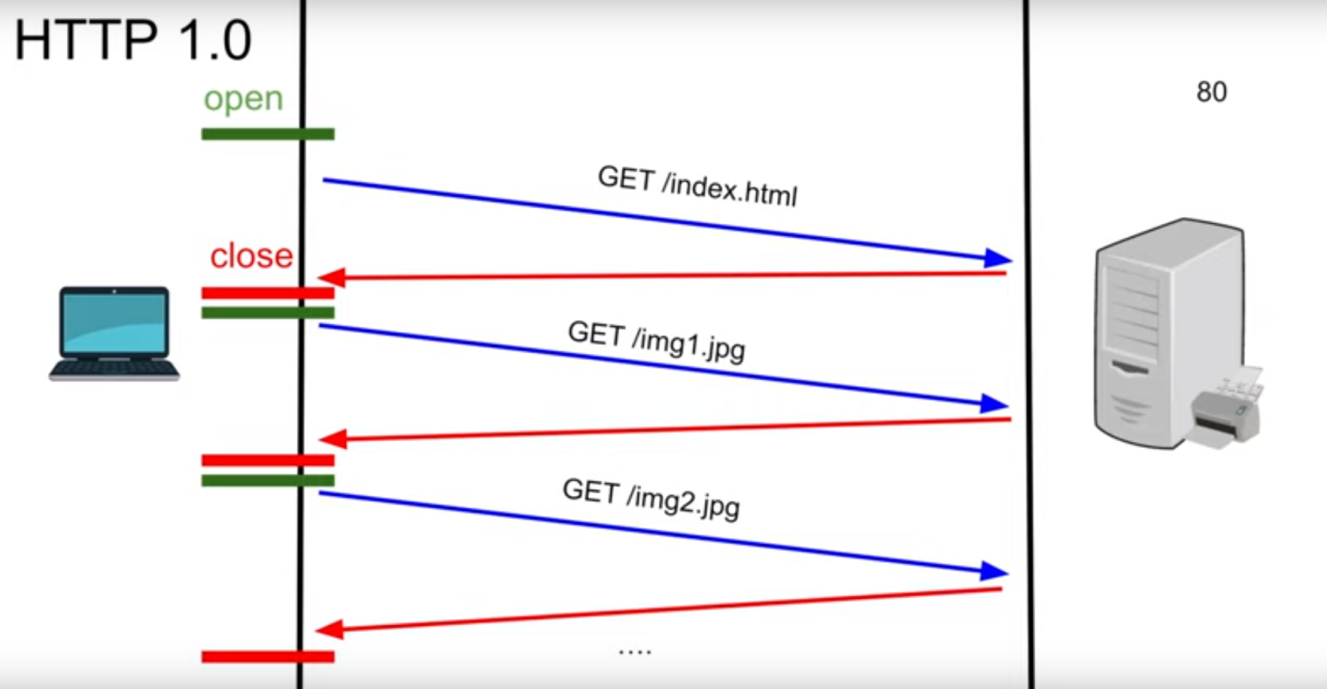
Http 1.0

Slide 4
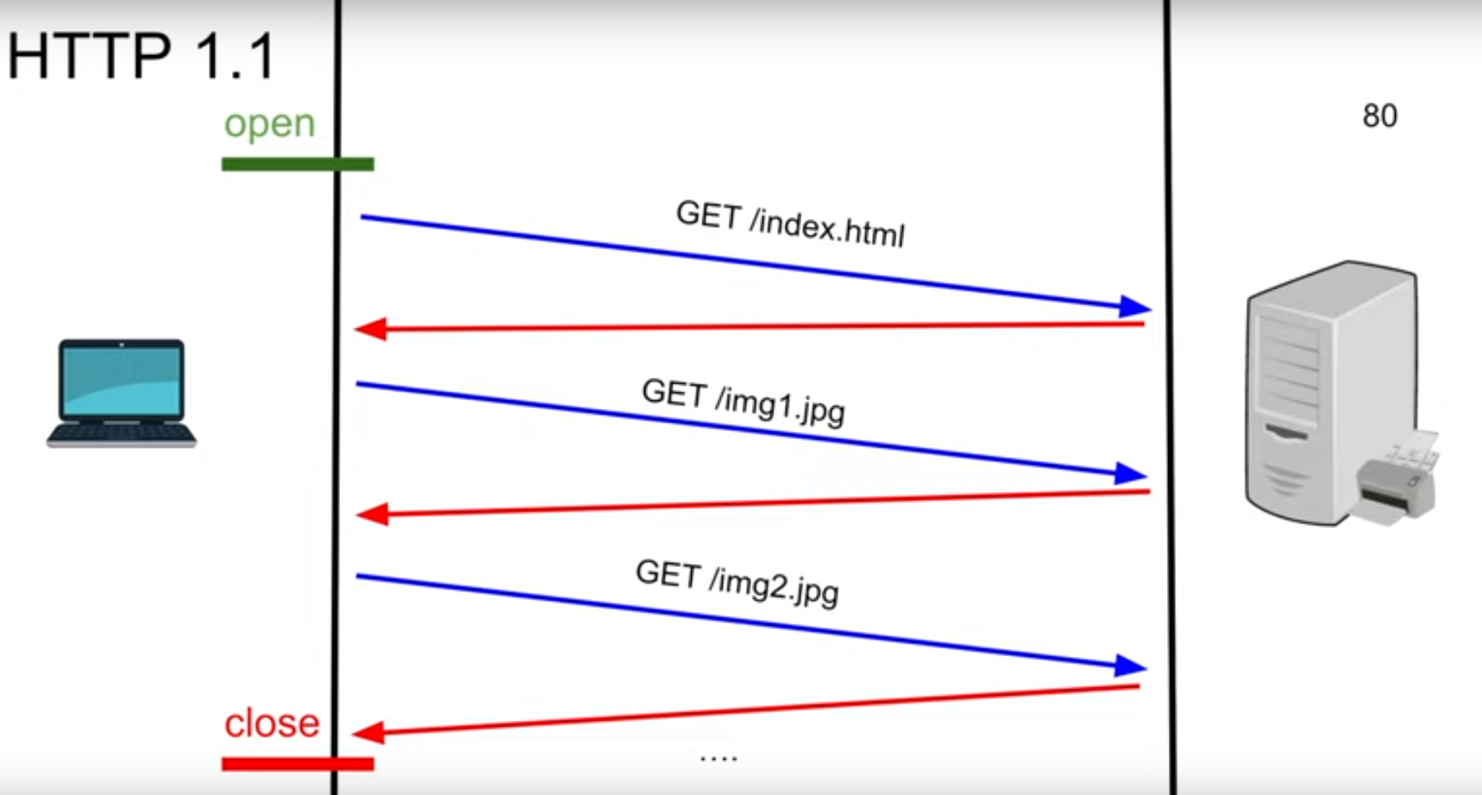
Http 1.1

Slide 5
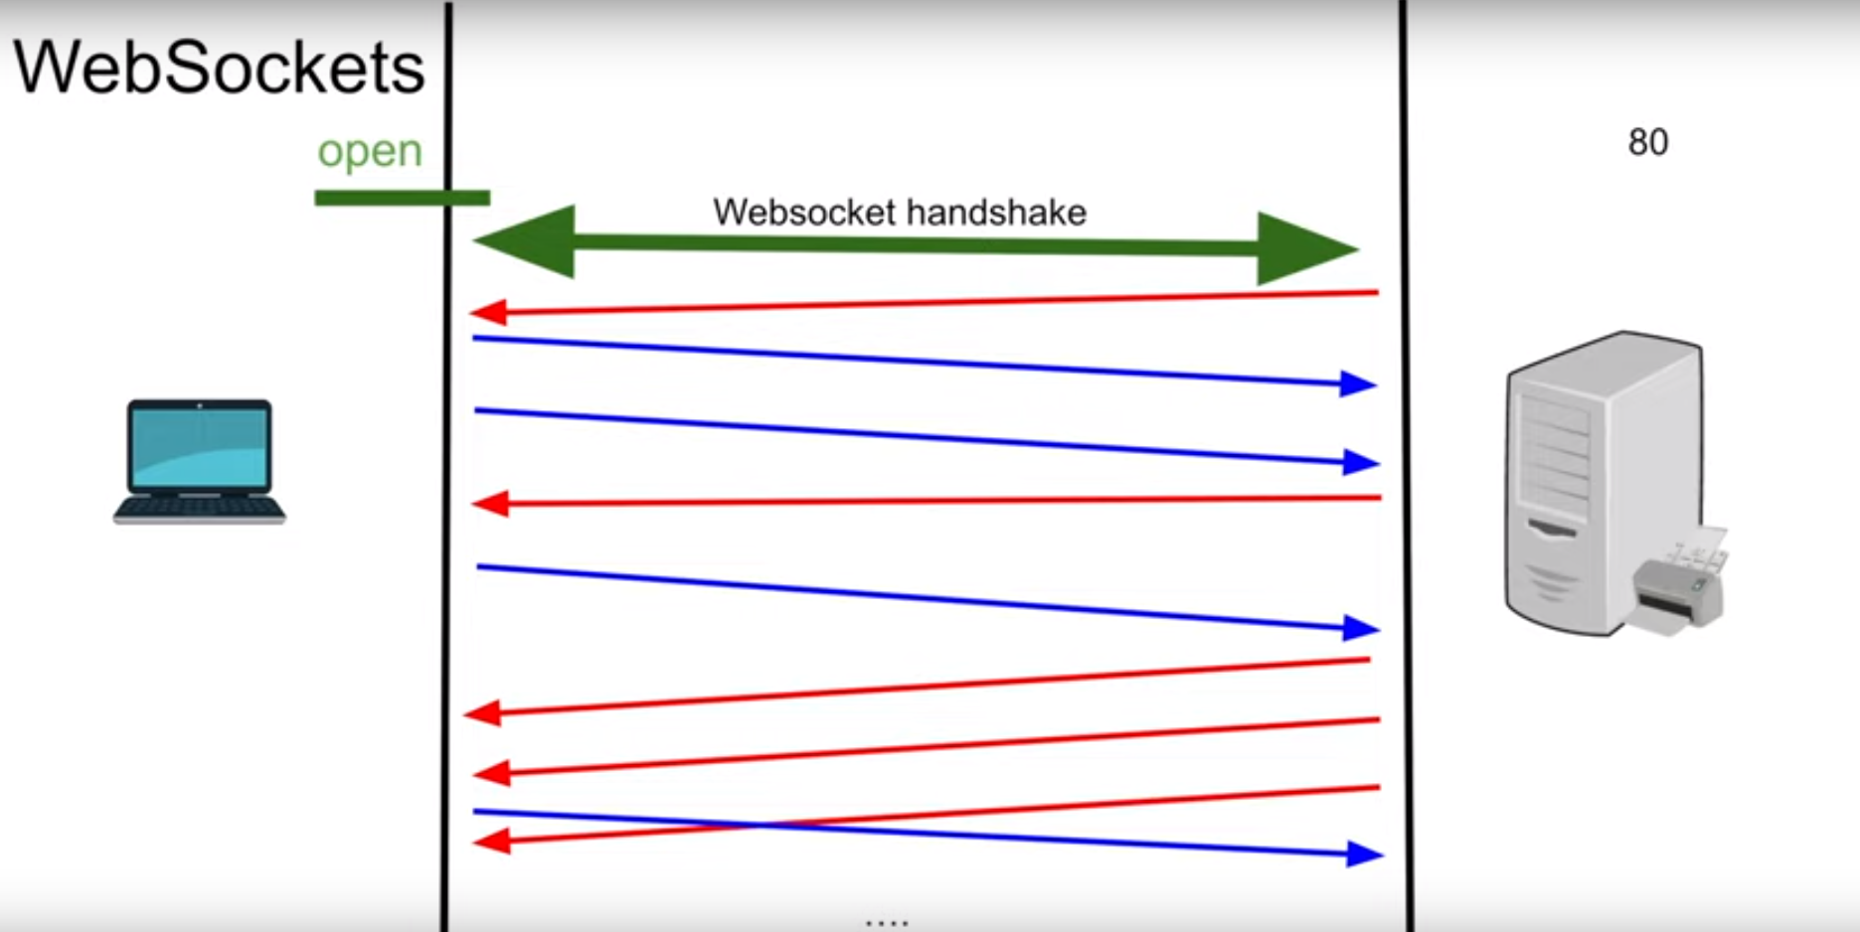
WebSockets

Slide 6
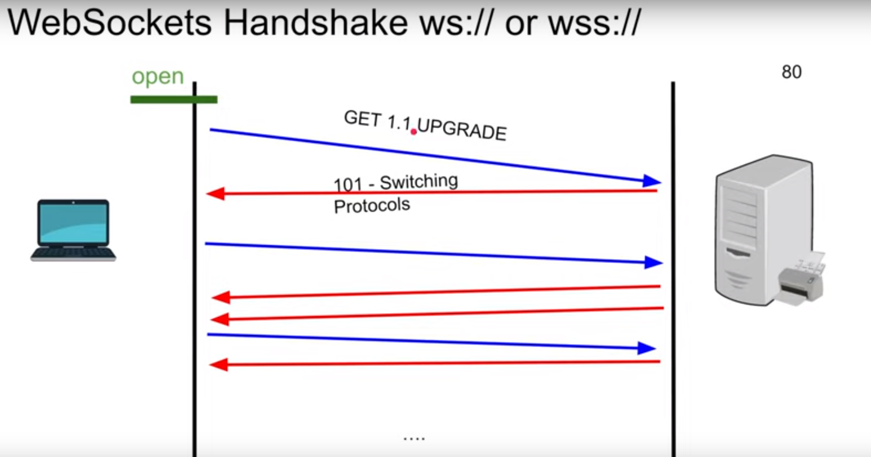
WebSocket Handshake

Slide 7
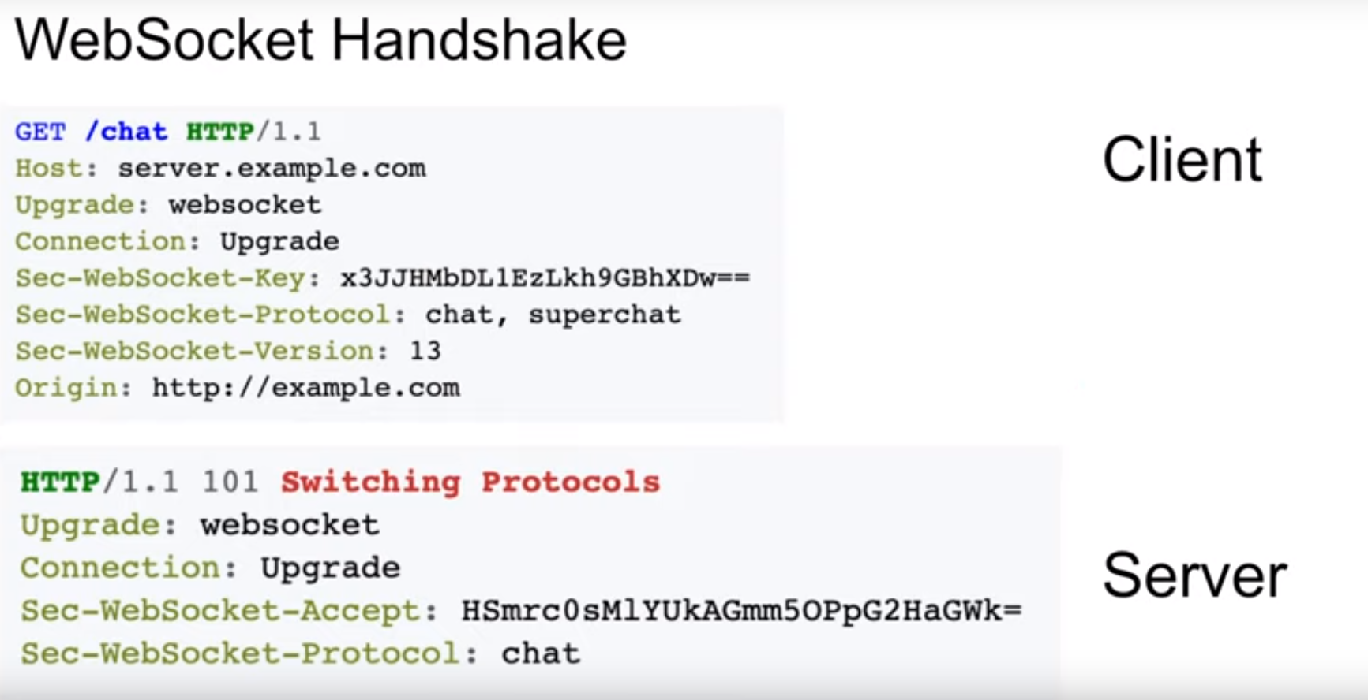
How Header looks like

Slide 8
WebSocket UseCases
Chatting Apps
Live Feed
Multiplayer Gaming
Stock Exchange apps etc…………………

Slide 9
Pros
Full Duplex (no Polling)
Http Compatible
Firewall Friendly

Slide 10
Cons
Load Balancing is Challenging (timeouts)
Stateful, difficult to horizontally scale
Proxying is Difficult

Slide 11
What is Socket.io????????????????????????????

Slide 12

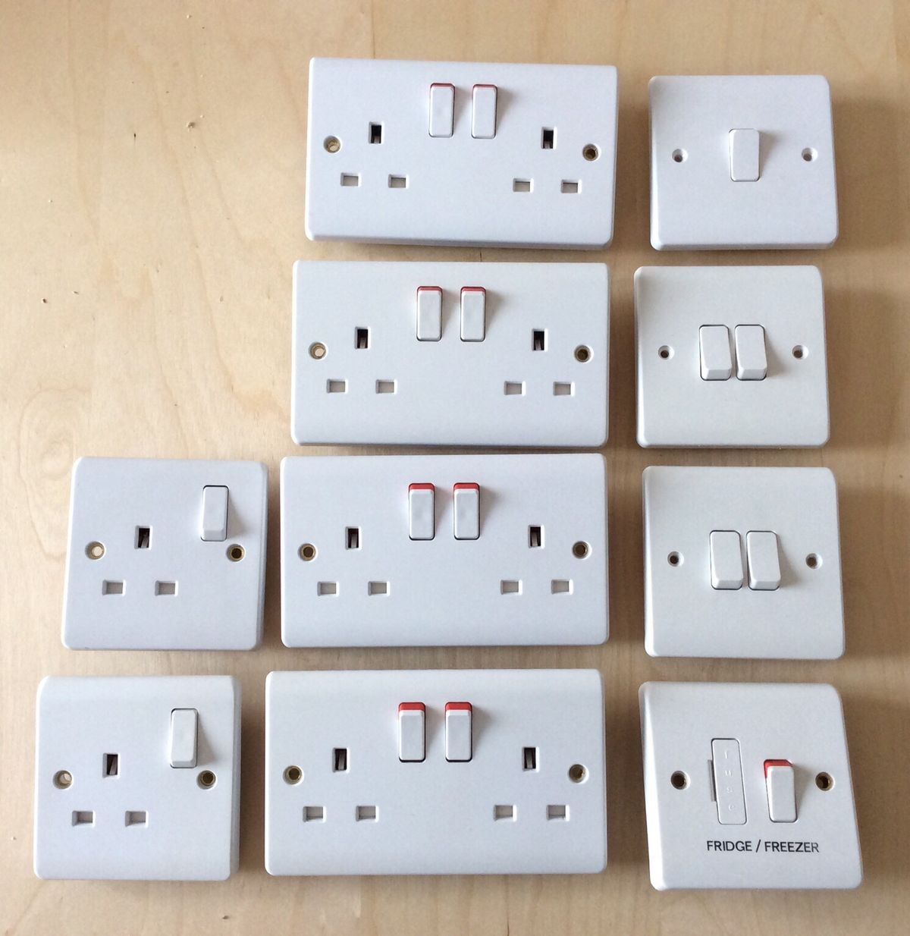
Happy Socket Programming

